Slide 1
Intro to version control
AI2C Tech Intro
Jul 2026

Slide 2
Objectives
Discuss basic git concepts
Use basic git commands to manage a local repository
Use basic git commands to view a repository’s history and changes

Slide 3

Version control

Slide 4
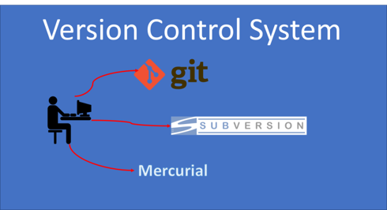
Common version control systems (VCS)
93% of developers use git

Slide 5

Git
Made by Linus Torvalds
Wrote the basics in about two weeks
The first commit was for git itself

Slide 6
why git?
Quoting Linus: "I'm an egotistical bastard, and I name all my projects after myself. First 'Linux', now 'Git'".
Alternatively, in Linus' own words as the inventor of Git: "git" can mean anything, depending on your mood:
Random three-letter combination that is pronounceable, and not actually used by any common UNIX command. The fact that it is a mispronunciation of "get" may or may not be relevant.
Stupid. Contemptible and despicable. Simple. Take your pick from the dictionary of slang.
"Global information tracker": you're in a good mood, and it actually works for you. Angels sing and light suddenly fills the room.
"Goddamn idiotic truckload of sh*t": when it breaks

Slide 7
Basic ideas
Terminology:
Repository (today)
Clone (today)
Stage (today)
Commit (today)
Branch (later)
Merge (later)
Fetch (later)
Pull (later)
Push (later)
Process:
Initialize repository (or clone)
Make changes
Stage changes
Commit changes
???
Profit

Slide 8
Git Commit / Reset / Revert
Command:
git commit -m "message"
git commit -a -m "message"
git commit --amend
git reset HEAD~
git revert <commit>
Description:
Commit staged changes with a message.
Stage all modified (tracked) files and commit.
Modify the last commit (message or content).
Undo the last commit but keep the changes unstaged.
Create a new commit that reverses a specific commit.

Slide 9
Hands-On #1
Initialize repository
Make some changes
Observe effects of changes
Stage changes
Commit changes

Slide 10
But why…
Most developer teams are not just one person
Having version control limits hassle across changes / teams
See how the code has changed over time
Analyze those changes for problem areas
(an aside) Not just for code…

Slide 11
Git History
I keep telling you that you can see what changed
So… how do we do that?
First we need to learn to read diffs…

Slide 12
Git Diff
Command:
git diff
git diff --cached
git diff HEAD
git diff <commit1> <commit2>
git diff <branch1> <branch2>
git diff <commit> <file>
Description:
Show unstaged changes.
Show staged changes.
Compare working directory with last commit.
Compare two commits.
Show differences between two branches.
Compare a file between commits.

Slide 13
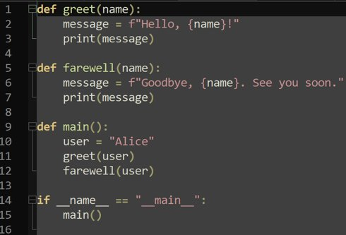
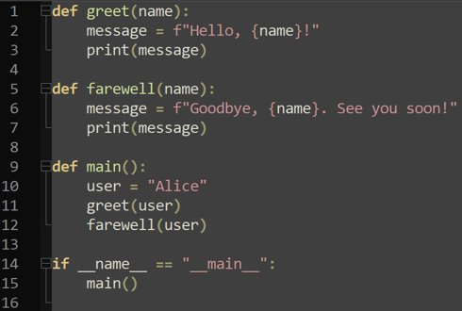
Spot the diff

Slide 14
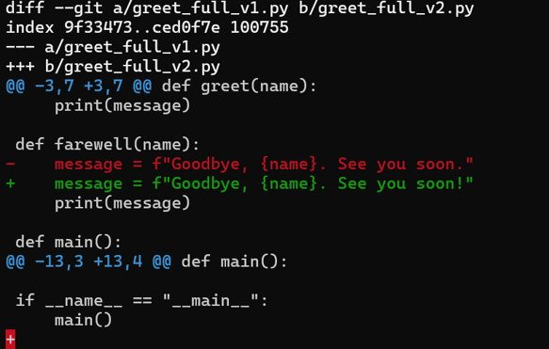
Spot the diff
Diffed two files
File metadata…
File “a” is denoted by ‘-’
File “b” is denoted by ‘+’
TEXT

Slide 15
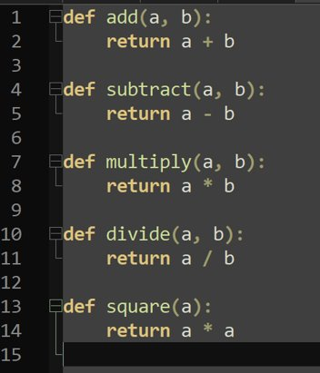
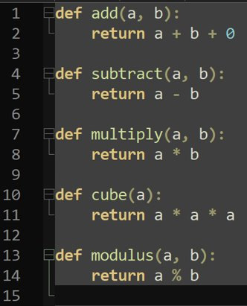
Spot the diff, again

Slide 16
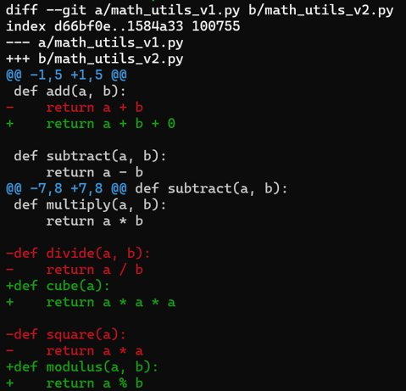
Spot the diff, again

Slide 17
Git Log
Command:
git log
git log --oneline
git log -p
git log --stat
git log --graph
git log <file>
git log -n <num>
Description:
Show commit history.
Condensed log (1 line per commit).
Show log with diffs.
Show summary of changes per file.
Show commit history as a graph (great with branches).
Show commit history for a specific file.
Show the latest <num> commits.

Slide 18
Hands-On #2
Practice viewing file changes
Practice comparing commits

Slide 19
Why the command line???
Good practice using terminals
Not every UI exposes all the commands
Most servers are terminal-only
Using commands allows us to automate / script / chain
Reading documentation for command-line utilities is an art…

Slide 20
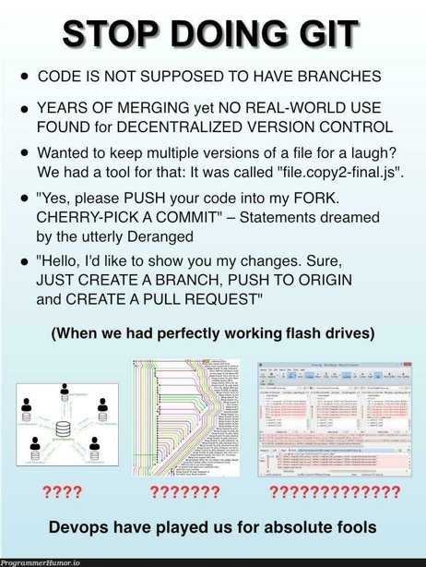
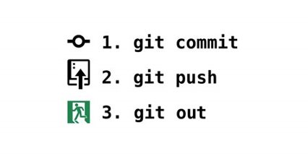
In Case of Fire…

Slide 21
Other Resources (HIGHLY RECOMMEND)
Oh My Git!
Learn Git Branching

Slide 22
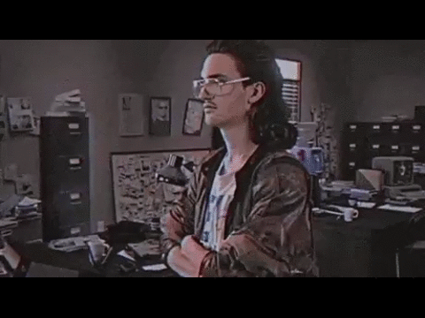
How are you feeling?

Slide 23
Finding help…
Often, `command --help`
Other times, `man command`
“Manual pages” -> “manpages” -> “man”
Of course:
Documentation
Stackoverflow
Reddit
Chatgpt
Google

Slide 24

Other useful commands
history – linux command history
grep – pattern matching utility
wc – word count – counts lines, words, chars or bytes in file
ssh – secure shell – connect to remote systems
|, >, >>, <, &&, || - ways to interact with a line

